Slide 2
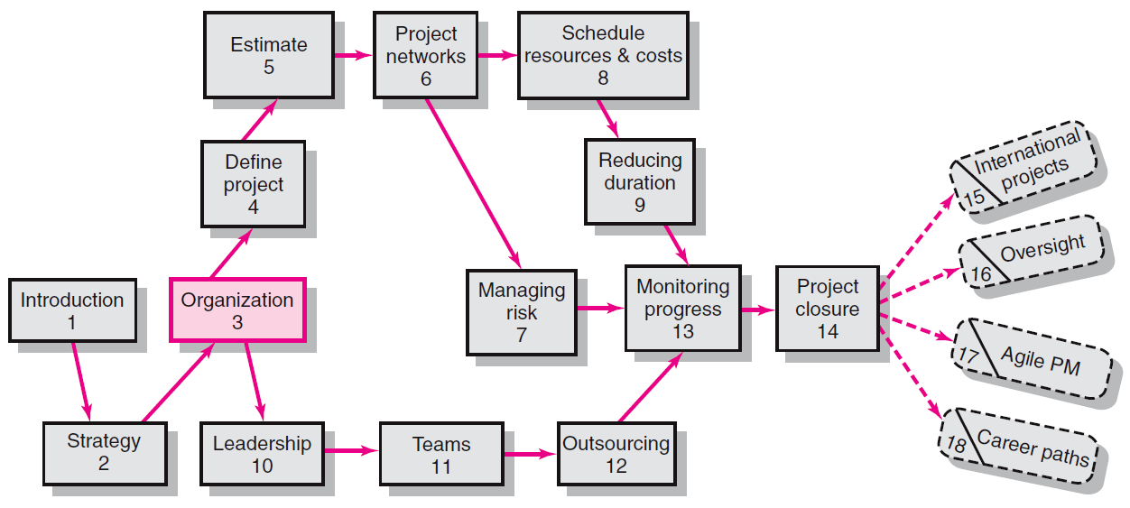
Where We Are Now
3–<number>

Slide 3
Organization: Structure and Culture
  Once Management approves a project, then the question arises:
  How will the project be implemented?
  Three different project management structures used by firms to implement projects:
  Functional organization
  Dedicated project teams
  Matrix structure
3–<number>

Slide 4
Project Management Challenges
Challenges to Organizing Projects
  The uniqueness and short duration of projects relative to ongoing longer-term organizational activities.
  Both project management structures and the culture of the organization constitute major elements of the environment in which projects are implemented.
3–<number>

Slide 5

Project Management Structures
Choosing an Appropriate Project Management Structure
  -- A project management system provides a framework for launching and implementing project activities within a parent organization
  The best system appropriately
  balances the needs of the project
  with the needs of the
  organization.
3–<number>

Slide 6
Project Management Structures
Organizing Projects within the Functional Organization
  One approach to organizing projects is to simply manage them within the existing functional hierarchy of the organization.
  Different segments of the project are delegated
  to respective functional units.
  Coordination is maintained through normal management channels.
3–<number>

Slide 7
Project Management Structures
Organizing Projects within the Functional organization
  -- For example a tool manufacturing firm decides to differentiate its product line by offering a series of tools especially designed for left-handed individuals.
  -- The industrial design dept., production dept. and marketing dept. are responsible for performing their respective duties within the hierarchy according to new product dimensions.
3–<number>

Slide 8
Project Management Structures
Organizing Projects within the Functional organization
  Functional organization is also used when, given the nature of the project, one functional area plays a dominant role in completing the project or has a dominant interest in the success of the project.
  For example a project involving the upgrading of the Management Information System would be managed by the information system department.
3–<number>

Slide 9
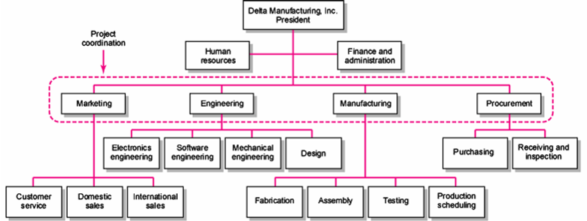
Functional Organizations
FIGURE 3.1
Copyright © 2006 The McGraw-Hill Companies. All rights reserved.
McGraw-Hill/Irwin 3–<number>

Slide 10
Functional Organization
Advantages
  No Structural Change
  Flexibility in hiring new staff
  In-Depth Expertise to deal with most crucial aspects of projects
  Easy Post-Project Transition because normal career paths are maintained. Specialists can contribute to projects considering their functional field as professional home.
3–<number>

Slide 11
Functional Organization
Disadvantages
  Lack of Focus by each functional unit to get things done
  Poor Integration across functional units
  Slow response time, lack of horizontal, direct communication
  Lack of Ownership, weak motivation & commitment level
3–<number>

Slide 12
Project Management Structures (cont’d)
Organizing Projects as Dedicated Teams
  Teams operate as separate units form the rest of the parent organization under the leadership of a full-time project manager.
  Project manager recruits necessary personnel from both within and outside the parent organization.
3–<number>

Slide 13
Project Management Structures (cont’d)
Organizing Projects as Dedicated Teams
  In some cases, parent organization maintains a tight rein through financial controls.
  In other cases, firms grant the project manager maximum freedom to get the project done.
  See snapshot from practice: Skunk Works
3–<number>

Slide 14
Project Management Structures (cont’d)
Organizing Projects as Dedicated Teams
  In a projectized organization such as consulting firms or construction firms where projects are the dominant form of business, entire organization or functional departments are responsible for providing support for its teams.
3–<number>

Slide 15
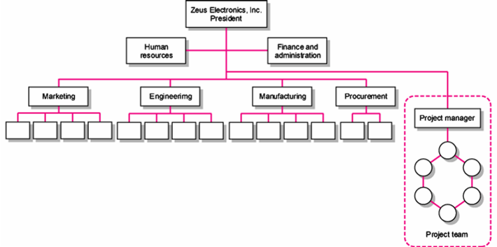
Dedicated Project Team
FIGURE 3.2
Copyright © 2006 The McGraw-Hill Companies. All rights reserved.
McGraw-Hill/Irwin 3–<number>

Slide 16
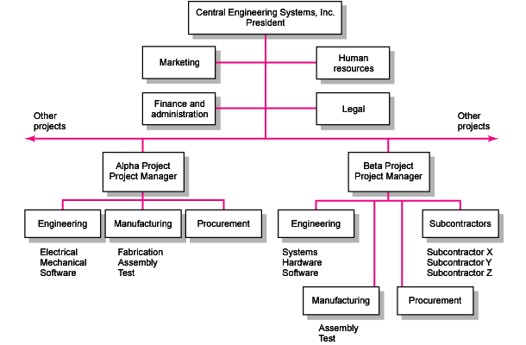
Project Organizational Structure
FIGURE 3.3
Copyright © 2006 The McGraw-Hill Companies. All rights reserved.
McGraw-Hill/Irwin 3–<number>

Slide 17
Project Organization: Dedicated Team
Advantages
  Simple: functional organization remain intact with project team operating independently.
  Fast: projects tend to get done more quickly. Participants devote full attention, perform duties and decision making within the organization.
  Cohesive: high motivation level, shared goals & responsibilities.
  Cross-Functional Integration: proper guidance, committed to achieve their mutual goals, not their respective areas of expertise.
3–<number>

Slide 18
Project Organization: Dedicated Team
Disadvantages
  Expensive: creation of new mgt. position as project manager, increased resource costs and a loss of economies of scale.
  Internal Strife: a disease known as projectitis develops. A strong We – They divisiveness emerges between project team and parent organization.
3–<number>

Slide 19
Project Organization: Dedicated Team
Disadvantages
  Limited Technological Expertise: technical expertise is limited somewhat to the talents and experience of the specialists assigned to the project because of the We-They syndrome.
  4. Difficult Post-Project Transition back to their original functional dept. because of prolonged absence and need to catch up with recent developments.
3–<number>

Slide 20
Project Management Structures (cont’d)
Organizing Projects within a Matrix Structure
  Hybrid organizational structure (matrix)in which a horizontal project management structure is “overlaid” on the normal functional hierarchy.
    Two chains of command (functional lines and project lines)
    Project participants report simultaneously to both functional and project managers.
3–<number>

Slide 21
Project Management Structures (cont’d)
  Organizing Projects within a Matrix Structure
  Matrix structure optimizes the use of resources.
    Allows for participation on multiple projects while performing normal functional duties.
    Achieves a greater integration of expertise and project requirements by creating and legitimizing the authority of a project manager.
3–<number>

Slide 22
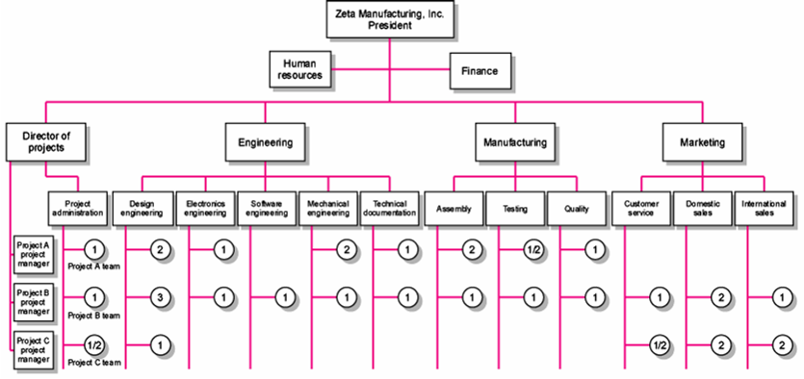
Matrix Organization Structure
FIGURE 3.4
Copyright © 2006 The McGraw-Hill Companies. All rights reserved.
McGraw-Hill/Irwin 3–<number>

Slide 23
Division of Project Manager and Functional Manager Responsibilities in a Matrix Structure
Project Manager Negotiated Issues Functional Manager
What has to be done? Who will do the task? How will it be done?
When should the task be done? Where will the task be done?
How much money is available to Why will the task be done? How will the project involvement
do the task? impact normal functional activities?
How well has the total project Is the task satisfactorily How well has the functional
been done? completed? input been integrated?
TABLE 3.1
Copyright © 2006 The McGraw-Hill Companies. All rights reserved.
McGraw-Hill/Irwin 3–<number>

Slide 24
Different Matrix Forms
Weak Form
  Similar to a functional approach with the exception that there is a formally designated project manager
  responsible for coordinating project activities, collecting information, status reports, checklist and schedules
  The authority of the functional manager predominates and the project manager has indirect authority.
3–<number>

Slide 25
Different Matrix Forms
Balanced Form
  The classic matrix in which the project manager sets the overall plan and the functional manager determines how work to be done.
  The merger of “what and how” requires both parties to work closely together.
  Jointly approve technical and operational decisions.
3–<number>

Slide 26
Different Matrix Forms
Strong Form
  This form attempts to create the “feel” of a project team within a matrix environment.
  The project manager has broader control and functional departments act as subcontractors
  to the project.
3–<number>

Slide 27
Project Organization: Matrix Form
Advantages
  Efficient: resources can be shared across multiple projects
  Strong Project Focus is provided by having a formally designated project manager
  Easier Post-Project Transition because project organization is overlaid on the functional divisions, specialists maintain ties with their functional group
  Flexible utilization of resources and expertise within the firm.
3–<number>

Slide 28
Project Organization: Matrix Form
Disadvantages
  Dysfunctional Conflict: matrix approach is predicated on tension between functional managers and project managers who bring critical expertise and perspectives to the project.
  Infighting can occur among project managers, who are primarily interested in what is best for their project.
  Stressful because participants have at least two bosses- functional head and project manager head.
  Slow process to coordinate and make decisions among different levels.
3–<number>

Slide 29

Choosing the Appropriate Project Management Structure
Organization Considerations
  How important is the project to the firm’s success?
  What percentage of core work involves projects?
  What level of resources (human and physical)
  are available?
3–<number>

Slide 30

Project Management Structures
What is the right structure?
Organizing Considerations
  if 75% or more of the work involves projects, consider fully projectized organization.
  If organization has both standard products and projects, use a matrix approach.
  If very few projects, dedicated teams can be used on an as-need basis.
  For sharing limited resources, use matrix.
  Try weak matrix first, less resistance.
Copyright © 2006 The McGraw-Hill Companies. All rights reserved.
McGraw-Hill/Irwin 3–<number>

Slide 31
Choosing the Appropriate Project Management Structure (cont’d)
Project Considerations
  Size of project
  Strategic importance
  Novelty and need for innovation
  Need for integration (number of departments involved)
  Environmental complexity (number of external interfaces)
  Budget and time constraints
  Stability of resource requirements
3–<number>

Slide 32
Choosing the Appropriate Project Management Structure (cont’d)
Project Considerations
  The higher the levels of these seven factors, the more autonomy and authority the project manager and project team need to be successful.
  This translates into using either a dedicated project team or a project matrix structure.
  These structures would be appropriate for complex, multidisciplinary projects as well as projects that require constant contact with customers.
3–<number>

Slide 33
Mixing and Matching Organizational Structure with Categories of Projects
A company may have 50+ projects, and use different structures for different types of projects
Advanced Development – high risk endeavors, creation of breakthrough product or process. (Use dedicated team.)
Platform – medium-risk, system upgrades that yield new products and processes. (Use strong matrix.)
Incremental – low-risk, short-term, that involve minor adjustments in existing products and processes. (Use weak matrix.)
Copyright © 2006 The McGraw-Hill Companies. All rights reserved.
McGraw-Hill/Irwin 3–<number>

Slide 34
Organizational Culture
Organizational Culture Defined
  A system of shared norms, beliefs, values, and assumptions which bind people together, thereby creating shared meanings.
  The “personality” of the organization that sets it
  apart from other organizations.
    Provides a sense of identify to its members.
    Helps legitimize the management system of the organization.
    Clarifies and reinforces standards of behavior.
3–<number>

Slide 35

Identifying Cultural Characteristics
Study the physical characteristics
of an organization.
Read about the organization.
Observe how people interact
within the organization.
Interpret stories and folklore
surrounding the organization.
3–<number>

Slide 36
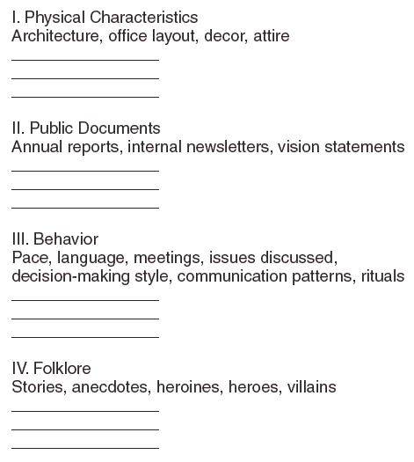
Organizational Culture Diagnosis Worksheet
FIGURE 3.8
Copyright © 2006 The McGraw-Hill Companies. All rights reserved.
McGraw-Hill/Irwin 3–<number>

Slide 37

Implications of Organizational Culture
for Organizing Projects
Challenges for Project Managers in Navigating Organizational Cultures
  Interacting with the culture and subcultures of the parent organization
  Interacting with the project’s clients or customer organizations
  Interacting with other organizations
  connected to the project
Copyright © 2006 The McGraw-Hill Companies. All rights reserved.
McGraw-Hill/Irwin 3–<number>

Slide 38
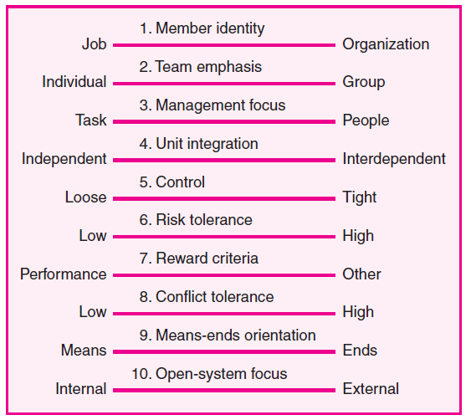
Cultural Dimensions of an Organization Supportive
of Project Management
FIGURE 3.5
Copyright © 2006 The McGraw-Hill Companies. All rights reserved.
McGraw-Hill/Irwin 3–<number>

Slide 39
Cultural Dimensions of an Organization Supportive
of Project Management
A B C D E
FIGURE 3.5
Copyright © 2006 The McGraw-Hill Companies. All rights reserved.
McGraw-Hill/Irwin 3–<number>

Slide 40
Key Terms
Balanced matrix
Dedicated project team
Matrix
Organizational culture
Projectitis
Projectized organization
Project Office (PO)
Strong matrix
Weak matrix
3–<number>

